Slide 1
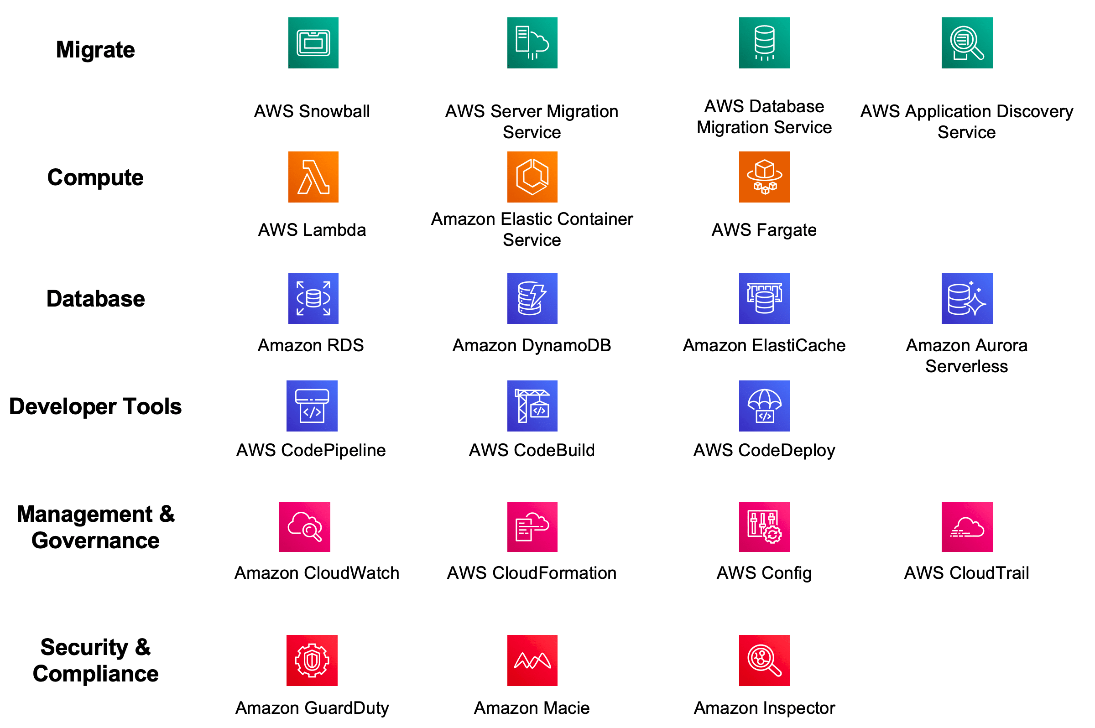
Amazon Web Services(AWS)
Exploring AWS Services:
Practical Examples & Case Studies

Slide 2
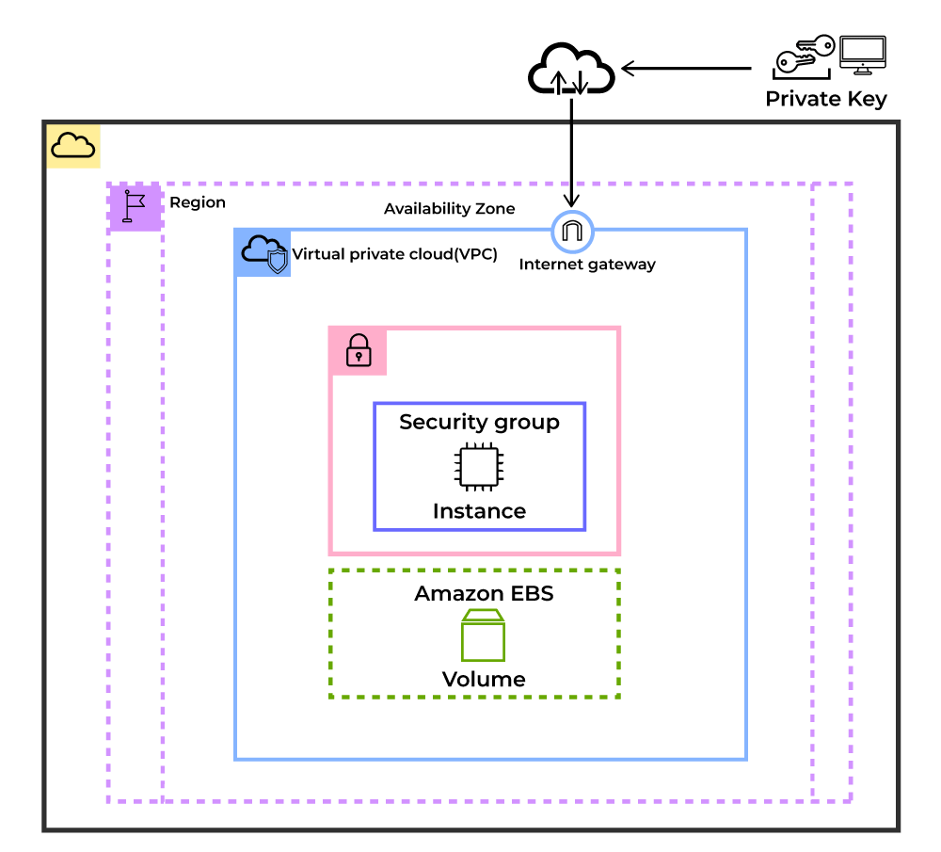
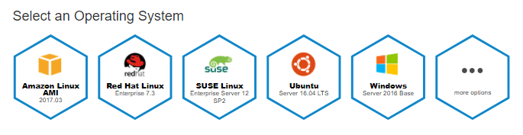
1.AMAZON ELASTIC COMPUTE CLOUD(EC2)
Deploying Application
Scaling the Application
Deploying the ML Models
Hybrid Cloud Environment
Cost-Effective
USE CASES:
Scalability
Flexibility
Reliability
Pay as you go model

Slide 3
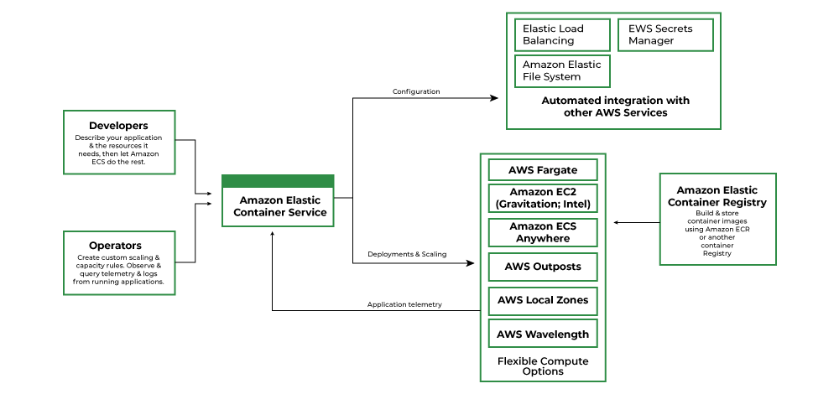
2.AMAZON ELASTIC CONTAINER SERVICE
Container
Docker
Cluster
Container Instance
ADVANTAGES:
Scalability
High Availability
Cost-Effective
Integration
Security

Slide 4
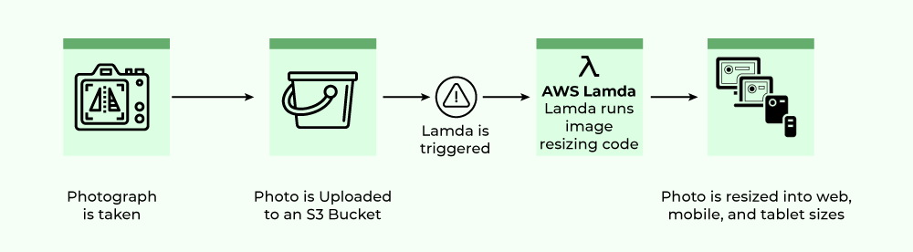
3. AMAZON LAMBDA
FEATURES:
File Processing
Web Applications
IoT
Stream Processing
Auto Scaling and High Availability
Serverless Execution
Pay per use pricing
Supports different programming languages
Versioning and Deployment
Security

Slide 5
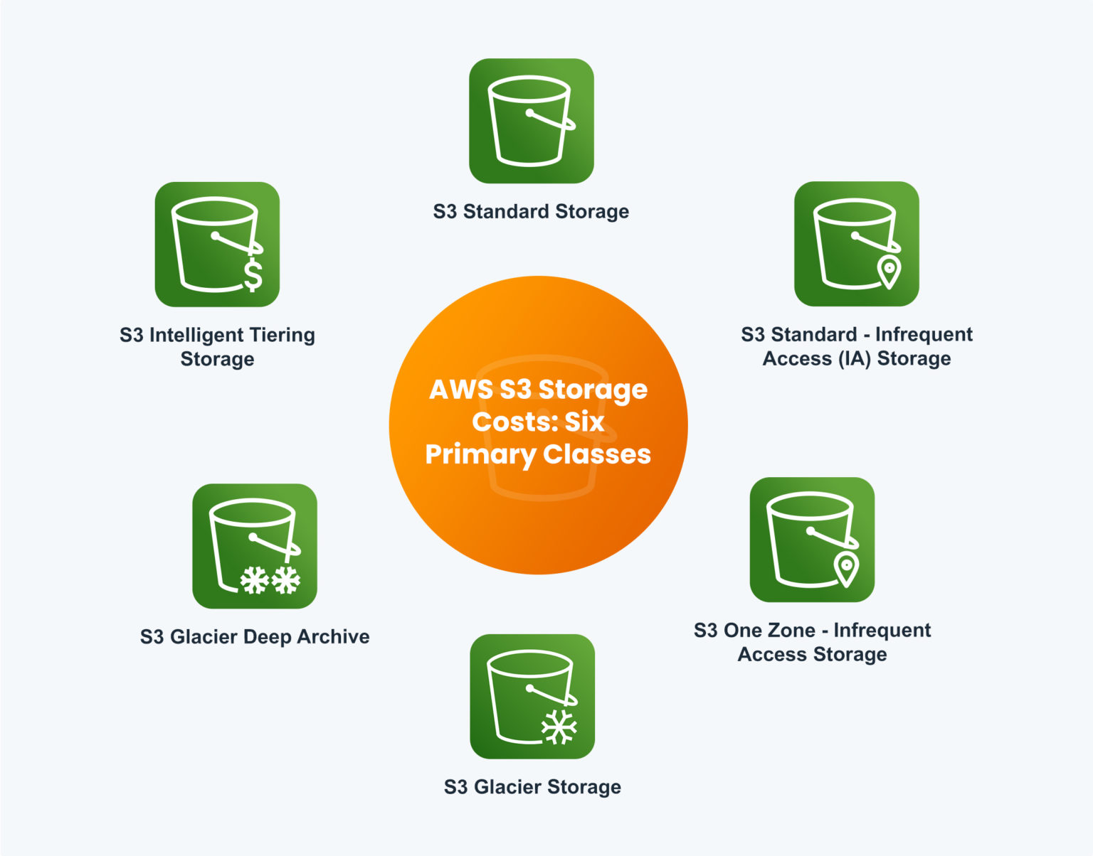
4. AMAZON SIMPLE STORAGE SERVICE
Data Usage
Backup and Recovery
Hosting Static Website
Data Archiving
Big Data Analytics
Amazon S3 Bucket: Data, in S3, is stored in containers called buckets.
Each bucket will have its own set of policies and configurations.
This enables users to have more control over their data. Bucket Names
must be unique. Can be thought of as a parent folder of data. There is
a limit of 100 buckets per AWS account. But it can be increased
if requested by AWS support.

Slide 6
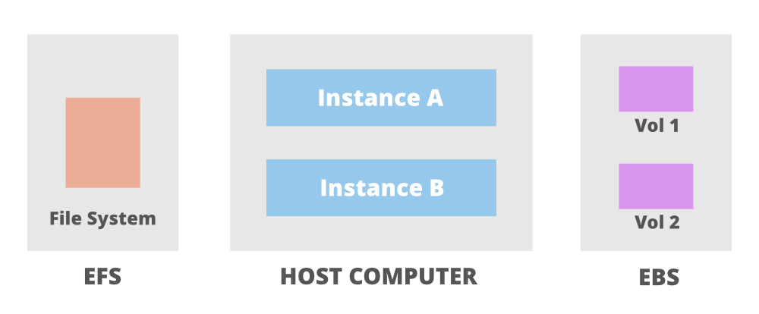
5. AMAZON ELASTIC BLOCK STORE
EBS is a block type durable and persistent storage that can be
attached to EC2 instances for additional storage. Unlike EC2
instance storage volumes which are suitable for holding temporary
data EBS volumes are highly suitable for essential and long term
data. EBS volumes are specific to availability zones and can only
be attached to instances within the same availability zone.
FEATURES:
Scalability
Backup
Encryption
Charges
EBS Volumes are independent of the EC2 instance they
are attached to. The data in an EBS volume will remain
unchanged even if the instance is rebooted or terminated.

Slide 7
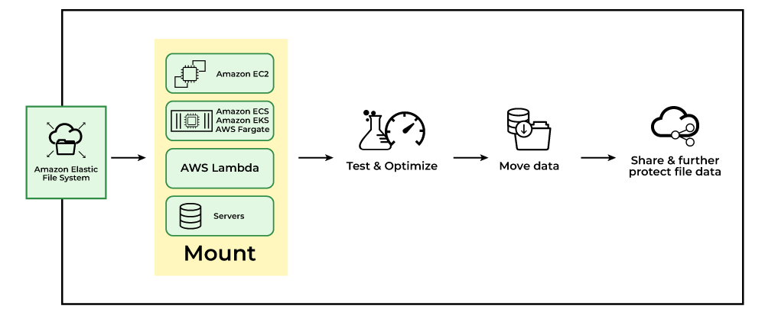
6. AMAZON ELASTIC FILE SYSTEM
Secured file sharing
Web hosting
Modernize application development
Machine Learning and AI workloads
USAGE:
Scalability
Simplified data sharing
Use the serverless application
Pay as you go model
EFS can be created using the EC2-Instance where it will be created in a specific region and distributed across
multiple availability zones for the purpose of high availability and durability.
You can choose the EFS based on the I/Ops you are going to perform.

Slide 8
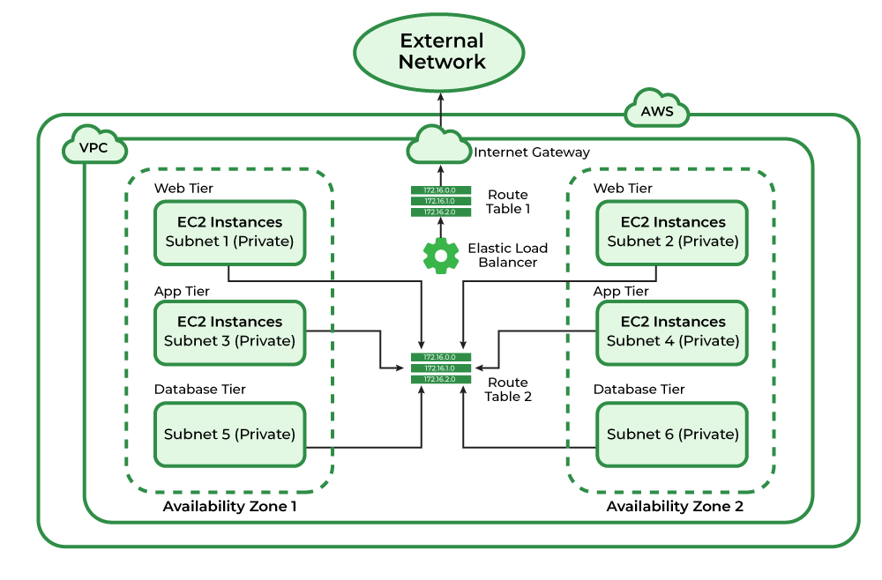
7. AMAZON VIRTUAL PRIVATE CLOUD
COMPONENTS:
Virtual Private Cloud
Subnetes
Route Tables
Network Access Control Lists
Internet Gateway
Network Address Translation
Amazon VPC can be referred to as the private cloud inside the cloud. It is a logical grouping of servers in a
specified network. The servers that you are going to deploy in the Virtual Private Cloud(VPC) will be completely
isolated from the other servers that are deployed in the Amazon Web Services.
You can have complete control of the IP address to the virtual machines and route tables and gateways to the
VPC.
With the help of security groups and network access control lists, you can protect your application more.

